Slide 1
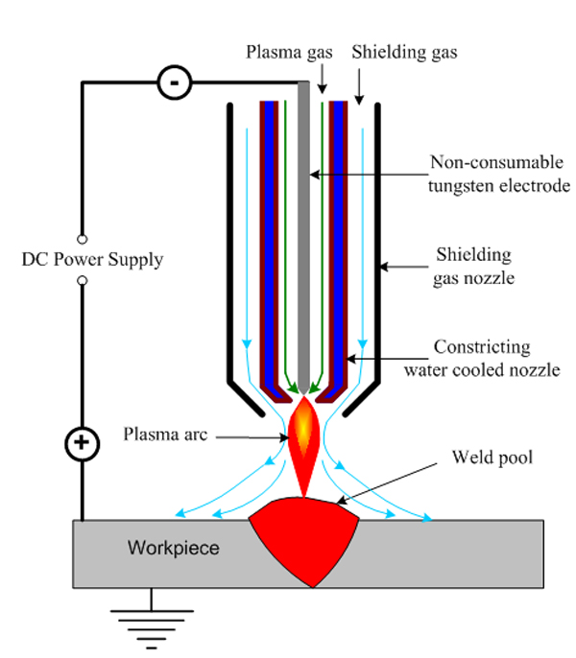
Plasma arc welding
Plasma -------- Ionized gas which conducts electric current.
In PAW, high temperature, high velocity ionized gas (plasma) is used to generate heat for fusion.
A small amount of pure argon gas flow is allowed through the inner office surrounding the tungsten electrode to form the plasma jet.
Because of the squeezing action of the constraining nozzle, the arc in plasma arc welding is concentrated and straight.

Slide 2
This constriction increases the heat contained per unit volume of the plasma arc .
Temperature ----- approx. 11000 ⁰C to 20000 ⁰C
Filler Material------added (if required)
The plasma gas itself is not sufficient to protect /shield the weld metal. Hence inert gases allowed to pass through outer nozzle surrounding the inner nozzle.
Shielding gases: Argon, Helium or mixture of Argon and Helium.
Power source: DCEN
Welding is done by keyhole method.
(The plate is burnt through the section forming a whole and then metal filled with forward movement).

Slide 3
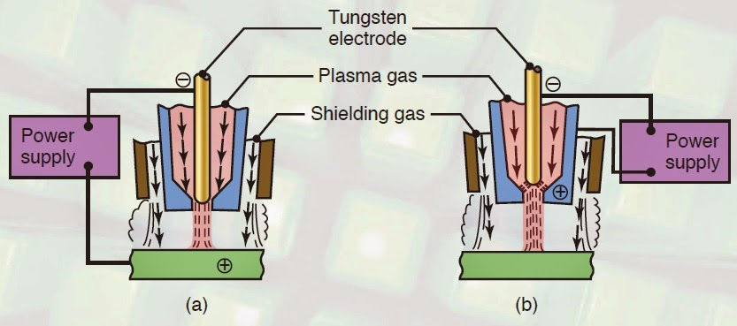
PAW process types:
A. Transferred Arc-----between electrode and work piece
B. Non transferred Arc ------between electrode and Nozzle.

Slide 4
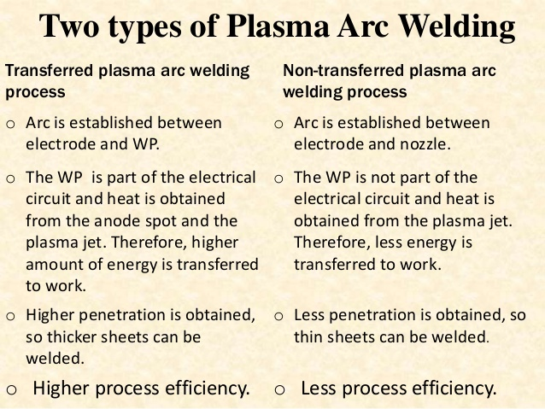

Slide 5
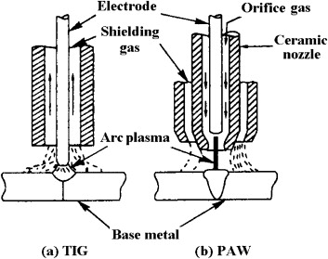
PAW is similar to GTAW (TIG) as both processes use inert gas and non consumable tungsten electrodes.
The main difference between the two is the construction of the torch.
In PAW the plasma arc is tightly constrained.

Slide 6
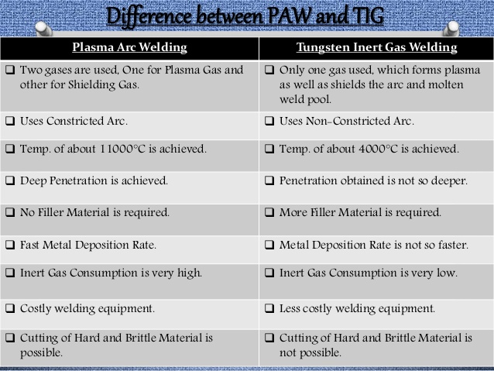

Slide 7
Advantages of PAW:
High penetration (Large depth to width ratios).
Arc length not influenced by “work to torch” distance.
Electrode will not touch the workplace. Hence no contamination of weld.
Lower heat input.
Less heat affected zone (HAZ) area.
Disadvantages:
Limited to thickness less than 25 mm.
Suitable for flat and horizontal positions only.
Applications: For stainless steel, nickel alloys, refractory metals like aluminium oxide (Al2O3) titanium oxide (Ti O2)

Slide 8
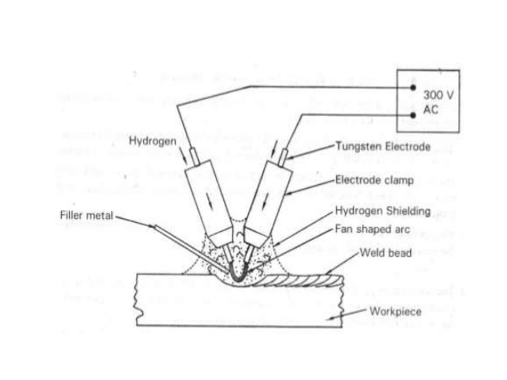
Atomic Hydrogen Welding (AHW)
In atomic hydrogen welding arc is struck between two non consumable tungsten electrodes.
A stream of hydrogen passes through an arc region.
The hydrogen molecule (H2), when passing through an electric arc, gets disassociated into two hydrogen atoms (H+). which is highly reactive.

Slide 9
Hydrogen atoms form hydrogen molecule and water vapor (to combine with oxygen if present) and release intense heat required for melting the joint.
The hydrogen atmosphere provided in the process protect the weld pool from atmospheric Oxygen and Nitrogen.

Slide 10
Power source: AC supply 15 – 50 Amps; 50-75 Volts
Electrode diameter---- 1 mm to 2.5 mm.
Advantages: Good quality welds.
Disadvantages
Not suitable for Al, Cu and their alloys.
High cost.
Applications:
For welding of tool steels containing W, Ni and Mo.
For repairing of moulds, dies and tools.
For hard facing.

Slide 11
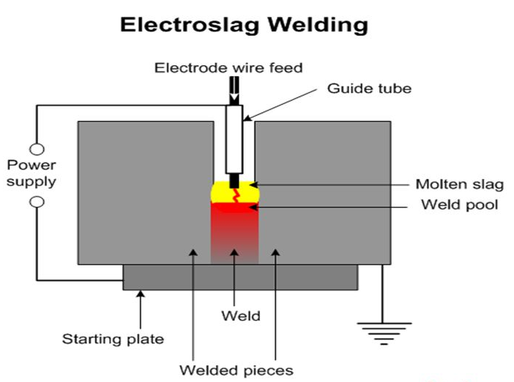
Electro Slag welding (ESW)
ESW developed to weld very large plates without any edge preparation.
It is a single pass process using a consumable electrode for filling the gap between the two heavy plates.
The heat required for melting the plates and electrode is obtained initially by means of an arc and later by the resistance of the slag.
Flux is required to maintain slag pool.
The arc is used only to initiate melting and there after heat is generated by electrical resistance offered by the slag which is sufficiently conductive to allow the current from the electrode to the weld pool.

Slide 12
Water cooled copper dams shoes are used to support and maintain the molten slag.

Slide 13
Advantages:
Suitable for welding thicker materials (50 mm-200 mm).
Better quality welds are possible due to vertical welding position as any gas present easily bubbles out through the slag.
No edge preparation is required.
Disadvantages:
Welds subject to high temperature and slow rate of cooling which results coarser structures.
Not suitable for materials having thickness less than 25 mm.
Applications:
For high pressure vessels; frames of heavy mechanical and hydraulic presses; rolling mill frames; ship hulls; locomotive frames etc.

Slide 14
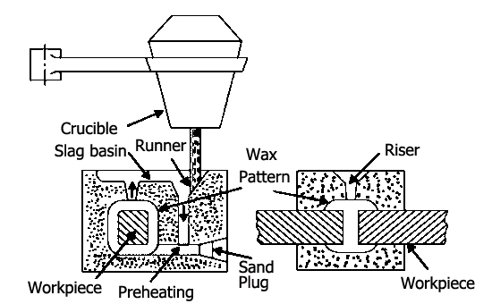
Thermit welding
Essentially like a casting process.
Uses moulds and pour the liquid metal between the joint space and allowed to solidify.
Heat source------ Exothermic reaction of thermit mixture.
Thermit mixture for steels--------- Al and Iron oxide.

Slide 15
when thermit mixture is ignited, the reaction takes place.
3 Fe₃O₄ + 8 Al--- 9 Fe+ 4Al₂O₃ + 3.01 MJ/ mol
The temperature is approximately 3000 ⁰C .
The complete reaction takes place with in a minute irrespective of the thermit mixture quantity.
Thermit mixture------- different for different materials.
Igniting mixture used for heating the thermit mixture is Barium peroxide or magnesium.

Slide 16
Applications:
For welding of very thick plates; large sections of locomotive rails; ship hulls and broken large castings.
Now a days not being used. Replaced by SAW.
Advantages:
Faster; Strong joints; safe process as non explosive.
Disadvantages:
Not suitable for thin sections.
Complex process.

Slide 17
Electron Beam Welding
In this welding process, a high jet of electrons strikes at welding plates where its kinetic energy converts into heat energy.
This heat energy is sufficient to melt the work pieces and fuse them into one piece.
This whole process carried out in vacuum otherwise the electrons collides with air particles and loses its energy.
Principle:
EBW uses kinetic energy of electrons to produce heat.
When a high jet of electrons strike at welding plates, its kinetic energy converts into heat energy.
This heat energy is sufficient to fuse two metal plates together to form a weld joint.

Slide 18
Equipment:
Power Supply:
Voltage ---- 5 – 30 kV for low voltage equipment’s or for welding thin plates
70 – 150 kV for high voltage equipment’s or for welding thick plates.
Electron Gun:
It is a cathode tube (negative pole) which generates electrons, accelerate them and focus it on a spot.
Made by tungsten or tantalum alloys.
The cathode filament heated up to 2500 0C for continuous emission of electrons.
Anode:
Positive pole which is just after the electron gun.
Main function is to attract negative charge, (in this case electron) provide them a path and don’t allow them to diverge from its path.

Slide 19
Magnetic Lenses:
Allows only convergent electrons to pass. They absorb all low energy and divergent electrons, and provide a high intense electron beam.
Electromagnetic lens
Used to focus the electron beam on work piece.
Deflection coil:
Deflect the beam at required weld area.
Work holding device:
Uses CNC table to hold work piece which can move in all three direction.
Vacuum Chamber:
Vacuum is created by mechanical or electric driven pump. The pressure ranges in vacuum chamber is about 0.1 to 10 Pa.

Slide 20
Working:
Electron gun (cathode), produces electrons which move towards anode.
Anode accelerates the electrons and form a electron jet which is further move towards magnetic lenses.
The magnetic lenses are a series of lenses which are used to absorb low energy electrons and does not allow to divergent electron to passes through it. It provides a high intense electron jet.
The electron beam passes through electromagnetic lens and defecting coil which are used to focus and deflect the electron beam at the required spot.
This unit direct high velocity electron beam to the weld cavity where its kinetic energy converts into heat energy due to collision.
This heat energy is used to create weld by fusion.
This whole welding process carried out in a vacuum chamber otherwise the electrons collides with air particle in the way and loses its energy.

Slide 21
Application:
Used in aerospace and marine industries for structural work.
Used to join titanium and its alloy.
Widely used to join gears, transmission system, turbocharger etc. in automobile industries.
To weld electronic connectors in electronic industries.
Used in nuclear reactors and in medical industries.

Slide 22
Advantages:
It can weld both similar and dissimilar metals.
It provides high metal joining rate.
Low operating cost because no filler material and flux are used.
It provide high finish welding surface.
It can used to weld hard materials.
Less welding defects occur as whole process carried out in vacuum.
Disadvantages:
High capital or set up cost.
High skilled labor required.
Frequently maintenance required. High maintenance cost.
Work pieces size is limited according to vacuum chamber.
It cannot do at site due to vacuum.

Slide 23
Laser Beam Welding
Light amplification by stimulated emission of radiation is called laser.
LBW is a fusion welding process in which two metal pieces are joined together by the use of laser.
The laser beams are focused to the cavity between the two metal pieces to be joined.
The laser beams have enough energy and when it strikes the metal pieces produces heat that melts the material from the two metal pieces and fills the cavity.
After cooling a strong weld is formed between the two pieces.

Slide 24
Working Principle
Electrons of an atom gets excited by absorbing some energy.
When it returns back to its ground state, it emits a photon of light.
The concentration of this emitted photon increased by stimulated emission of radiation.

Slide 25
Main Parts
Laser Machine: Used to produce laser for welding.
Power Source: A high voltage power source is applied across the laser machine to produce laser beam.
CAM: Laser machine is integrated with the computers to perform welding process. All the controlling action during the welding process by laser is done by CAM.
CAD: Used to design the job for welding.
Shielding Gas: A shielding gas may be used during the welding process in order to prevent the w/p from oxidation.

Slide 26
Types of Laser Used
Gas lasers: Mixtures of gases such as Nitrogen, Helium and Co2 are used as lasing medium.
Solid-state laser: Synthetic ruby crystal (chromium in aluminum oxide), neodymium in glass (Nd:glass), and neodymium in yttrium aluminum garnet (Nd-YAG , most commonly used).
Fiber laser: Optical fiber itself

Slide 27
Characteristics of Laser Beam Welding
High power density (1 MW/cm2).
Small heat-affected zones.
The rate of heating and cooling is high.
The laser beams are coherent ( having same phase) and monochromatic ( i.e. having same wavelength).
Used to weld smaller sizes spot but the spot sizes can vary from .2mm to 13 mm.
High penetration.
Pulsed or continuous laser beams are used for welding. Thin materials are weld by using millisecond-pulses and continuous laser beams are used for deep welds.
High quality welds.
Most popular in automotive industry.

Slide 28
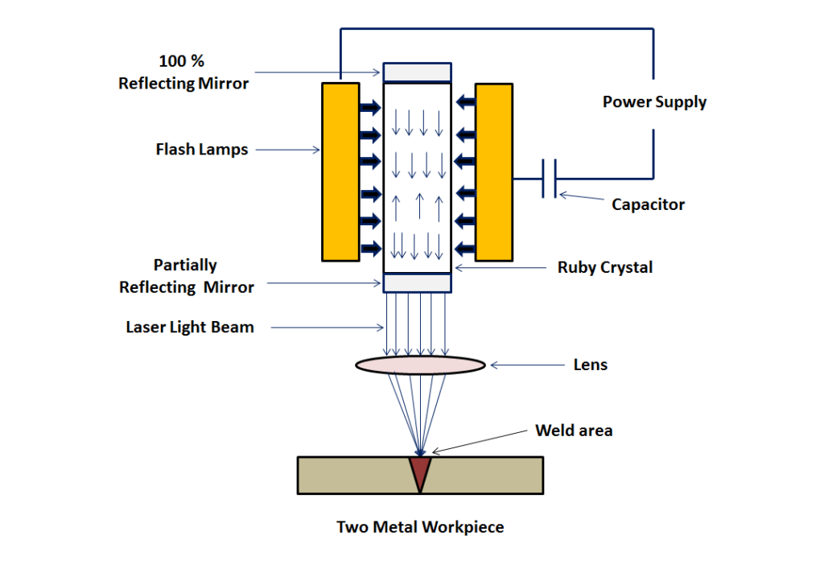
Working of LBW
A high voltage power supply is applied on the laser machine.
This starts the flash lamps of the machine and it emits light photons.
The energy of the light photon is absorbed by the atoms of ruby crystal and electrons get excited to their higher energy level.
When they return back to their ground state (lower Energy state) they emit a photon of light.

Slide 29
Working of LBW
This light photon again stimulates the excited electrons of the atom and produces two photons.
This process continues and results a concentrated laser beam.
This high concentrated laser beam is focused to the desired location for the welding of the multiple pieces together.
Lens are used to focus the laser to the area where welding is needed.
CAM is used to control the motion of the laser and work piece table during the welding process.
As the laser beam strikes the joint surface, it melts the base metal from both the pieces and fuses them together.
After solidification we get a strong weld.

Slide 30
Advantages
Produces high quality welds.
Easily automated.
No electrode is required.
No tool wears because it is a non-contact process.
The time taken for welding thick section is reduced.
It is capable of welding in those areas which is not easily accessible.
It has the ability to weld metals with dissimilar physical properties.
It can be weld through air and no vacuum is required.
X – Ray shielding is not required as it does not produce any X-Rays.
It can be focused on small areas for welding. This is because of its narrower beam of high energy.
Wide variety of materials can be welded by using laser beam welding.
It produces welds of aspect ratios (i.e. depth to width ratio) of 10:1.

Slide 31
Disadvantages
Initial cost is high.
High maintenance cost.
Due to rapid rate of cooling, cracks may be produced in some metals.
High skilled labour is required to operate LBW.
The welding thickness is limited to 19 mm.
The energy conversion efficiency in LBW is very low. It is usually below 10 %.
Application
The laser beam welding is dominant in automotive industry. It is used in the area where large volume production is required.

Slide 32
Ultrasonic Welding(USW) Process
Uses ultrasonic vibration of high frequency to weld the two pieces together.
Most commonly used to weld thermoplastic materials and dissimilar materials.
Metal with thin section can also be welded with USW.
Working Principle
A high frequency (20 kHz to 40 kHz) ultrasonic vibration is used to join two plastic pieces together.
The high frequency vibration generates heat energy at the interface of the two pieces and melts the material.
The melted material fused with each other to form a strong weld on cooling and solidification.
The typical frequency used is 15, 20, 30, 35 or 40 kHz.

Slide 33
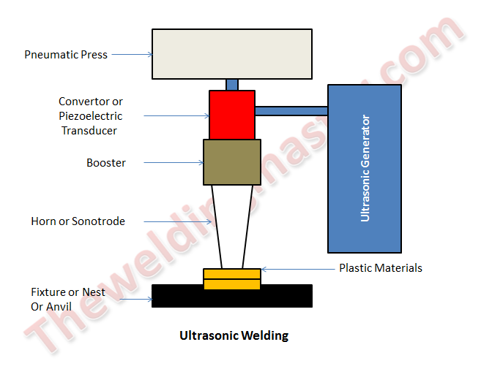
Main Parts
A Press: To apply pressure on the two pieces to be joined. It may be of pneumatic or electric driven type.
Nest or anvil or fixture: Clamping device used to hold and clamp the two pieces together. Direct the high frequency vibration to the interface of the two pieces.
An Ultrasonic Stack: It consists of three components, a converter or piezoelectric transducer, a booster and a horn or sonotrode.
Converter: Converts the electrical signals into high frequency mechanical vibration.

Slide 34
Booster: It modifies the amplitude of vibration mechanically.
Horn or Sonotrode: It vibrates at high frequency and transmits the mechanical vibration to the two pieces to be welded. It also modifies the amplitude mechanically. It takes the shape of the part. The horn is made of titanium or aluminum.
An Ultrasonic Generator: It generates and delivers high frequency electrical signal matching the resonance frequency of the stack.
Controller: Used to control the movement of the press and delivery of the ultrasonic energy.

Slide 35
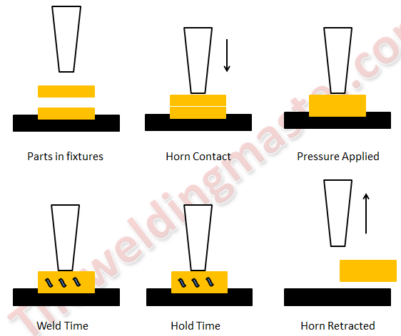
Working Process of Ultrasonic Welding
The two pieces to be joined assembled in the nest (anvil or fixture)
The horn is made to contact at upper part of the piece.
A pressure is applied on the two pieces against the fixture. The pressure is applied through the pneumatic or electric driven press.
Horn is vibrated vertically at very high frequency (20 kHz to 40 kHz), transmits the mechanical vibration to the two plastic pieces. This generates heat energy at contact tip of the two surfaces and melts them.

Slide 36
A clamping force is applied on the two pieces for a predetermined amount of time to fuse them together to form a strong weld on cooling and solidification.
After solidification, the clamping force is removed and horn retracted. The welded plastic part is taken out of the fixture as one piece.
Advantages
Fast welding process.
It has Quick drying time i.e. the pieces do not remain for a long time in the fixtures to dry.
Can be easily automated.
Produces clean and precise joint.
Produces low thermal impact on the materials.
Disadvantages
It cannot be used to produce large joints (more than 250 x 300 mm).
High tooling cost for the fixtures.
It is restricted to the lap joints.

Slide 37
Application
Mostly used in computer and electrical, aerospace and automotive, medical, and packaging industries.
Computer and Electrical Industries: Used to join wired connections and to create connections in small delicate circuits.
Aerospace and Automotive Industry:
Automotive industries----Used to assemble large plastic and electrical components such as door panels, instrument panels, air ducts, lamps, steering wheels, and upholstery and engine components.
Aerospace ----Used to join thin sheet gauge and lightweight materials like Al.
Medical Industry
Does not introduce any contaminants or degradation into the weld. Items such as anesthesia filters, arterial filters, blood filters, dialysis tubes, pipettes, blood/gas filters, cardiometry reservoirs etc. can be made using ultrasonic welding method.
Packaging Industry
Used to package different materials in food industries.
It is used for packaging dangerous materials like explosives, fireworks and chemical.

Slide 38
THANK YOU

